Slide 1
3.2 The first order optimality condition

Slide 2
In this Section we discuss the foundational first order concept on which many practical optimization algorithms are built: the first order optimality condition.
This is the first order analog of the zero order condition discussed in the previous Chapter.
The first order condition codifies the consistent behavior of how any differentiable function's first derivative(s) behave at its minima and maxima.

Slide 3
The first-order condition

Slide 4
Below we plot a quadratic functions in two and three dimensions, and mark the global minimum point on each with a green point.
In each panel we also draw the first order Taylor series approximation - a tangent line/hyperplane - generated by the first derivative(s) at the function's minimum value.
In terms of the behavior of the first order derivatives here we see - in both instances - that the tangent line/hyperplane is perfectly flat, indicating that the first derivative(s) is exactly zero at the function's minimum.

Slide 5
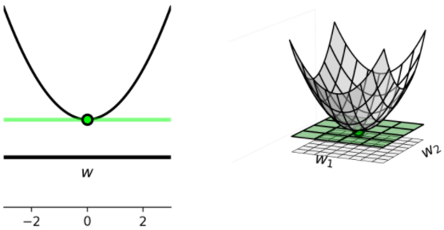

Slide 6
This sort of first order behavior is universal regardless of the function one examines and - moreover - it holds regardless of the dimension of a function's input.
That is, first order derivatives are always zero at the minima of a function.
This is because minimum values of a function are naturally located at 'valley floors' where a tangent line or hyperplane tangent to the function is perfectly flat, and thus has zero-valued slope(s).

Slide 7
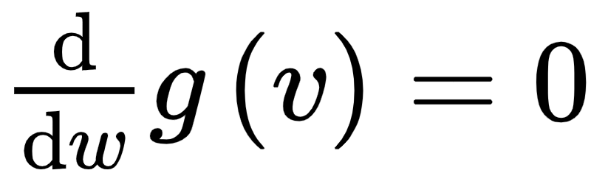
Codifying this in the language of mathematics, when N=1 any point v where
is a potential minimum.

Slide 8

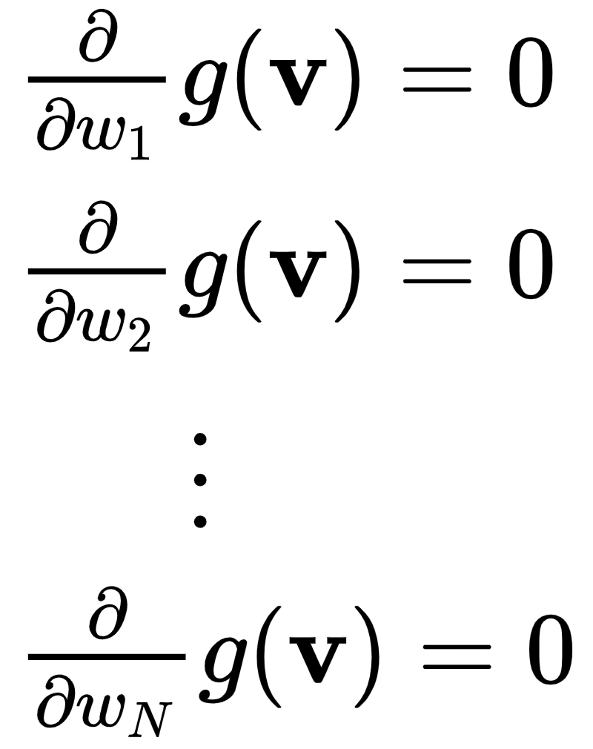
Analogously with general N dimensional input, any N dimensional point where every partial derivative of g is zero, that is
is a potential minimum.

Slide 9
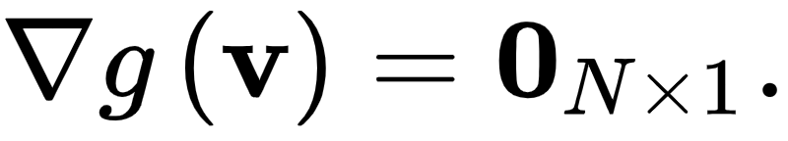
This system of N equations is naturally referred to as the first order system of equations.
We can write the first order system more compactly using gradient notation as

Slide 10
In principle this is a very useful characterization of minimum points.
It gives us a concrete alternative to seeking out a function's minimum points directly via some zero-order approach.
The alternative - solve a function's first order system of equations.

Slide 11
However two problems with the first order characterization of minima.
First off, with few exceptions it is virtually impossible to solve a general function's first order systems of equations 'by hand'.
That is, to solve such equations algebraically for 'closed form' solutions one can write out on paper.

Slide 12
The other problem: the first order optimality condition does not define only minima of a function, but other points as well.
The first order condition also equally characterizes maxima and saddle points of a function - as we see in a few simple examples below.

Slide 13
Example: Finding points of zero derivative for single-input functions graphically

Slide 14
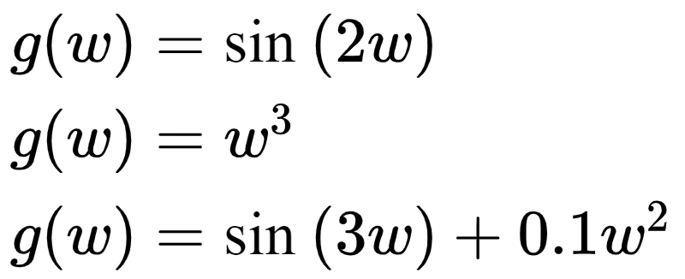
Below we plot the three functions

Slide 15
For each we mark all the zero derivative points in green and draw the first order Taylor series approximations/tangent line.
Below each function we plot its first derivative, highlighting the points where it takes on the value zero as well.

Slide 16
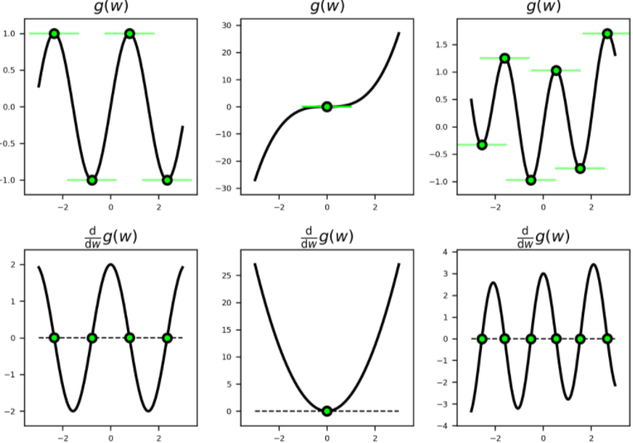

Slide 17
local minima or points that are the smallest with respect to their immediate neighbors, like the one around the input value w=2 in the right panel
local and global maxima or points that are the largest with respect to their immediate neighbors, like the one around the input value w=-2 in the right panel
saddle points like the one shown in the middle panel, that are neither maximal nor minimal with respect to their immediate neighbors

Slide 18
The previous example illustrate the full swath of points having zero-valued derivative(s).
This includes multi-input functions as well regardless of dimension.
Taken together all such points are collectively referred to as stationary points or critical points.

Slide 19
Special cases where the first order system can be solved 'by hand'

Slide 20
There are a handful of relatively simple but important examples where one can compute the solution to a first order system by hand.
Or, at least, one can show algebraically that they reduce to a linear system of equations which can be easily solved numerically.

Slide 21
Example: Calculating stationary points of some single-input functions algebraically

Slide 22
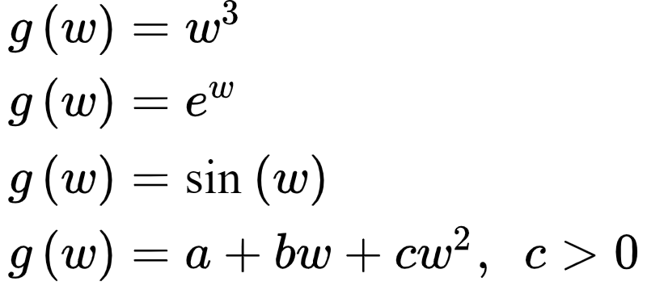
In this Example we use the first order condition for optimality to compute stationary points of the functions

Slide 23
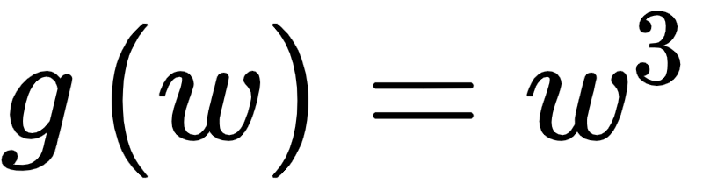
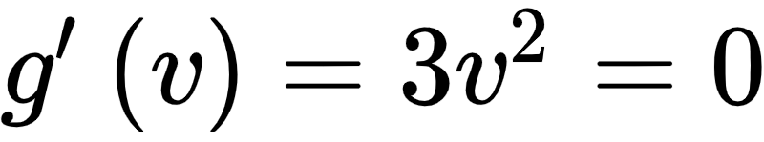
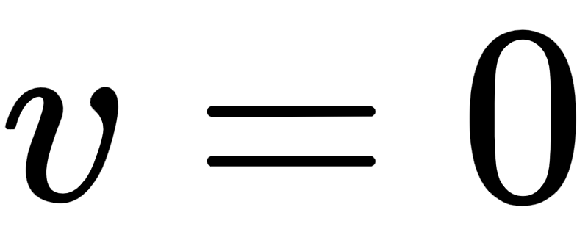
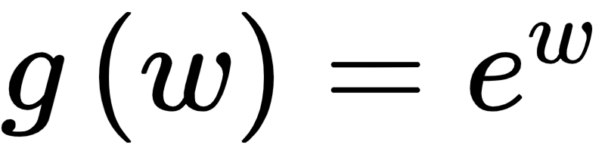
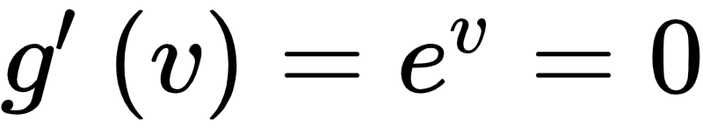
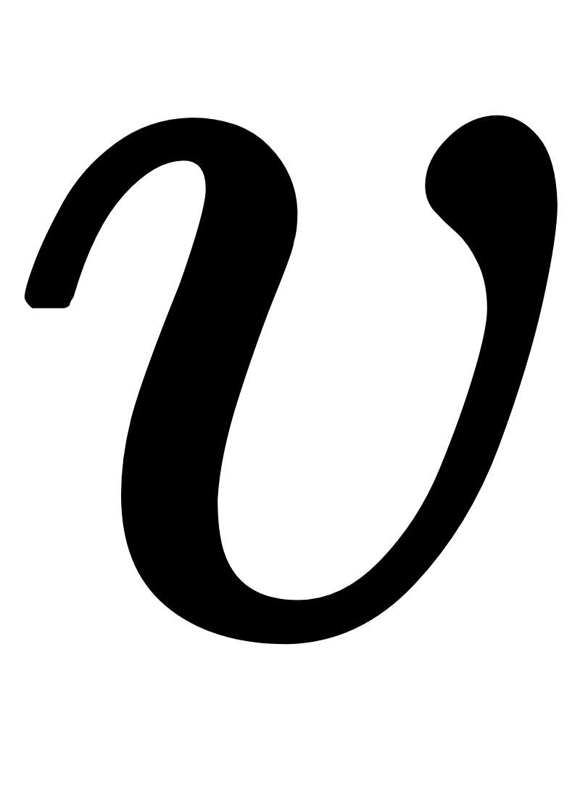
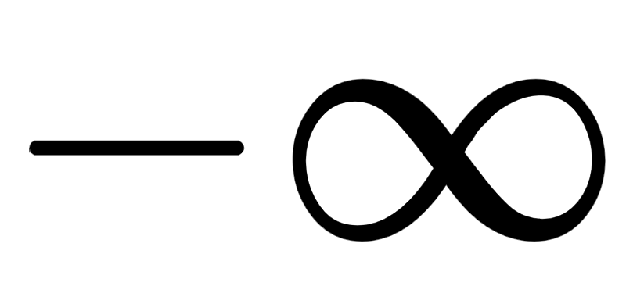
, plotted in the middle panel of the second figure above, the first order condition gives which we can visually identify as a saddle point at .
, the first order condition gives which is only satisfied as goes to , giving a minimum.

Slide 24
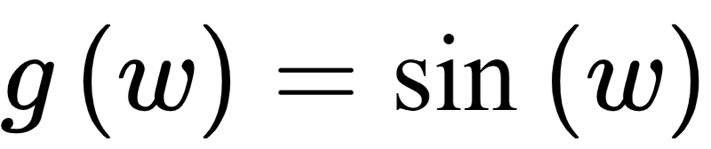
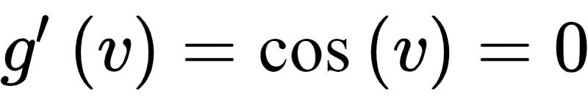
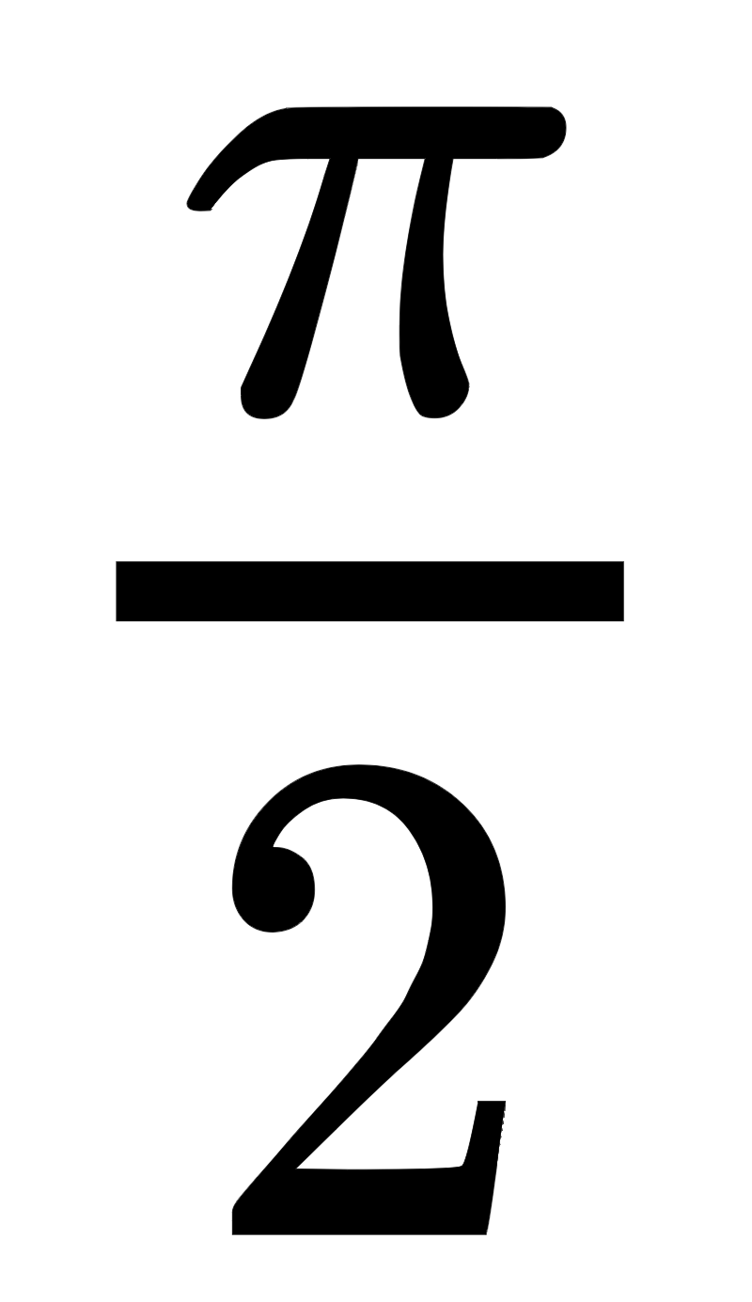
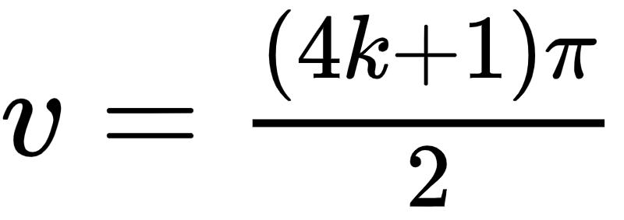
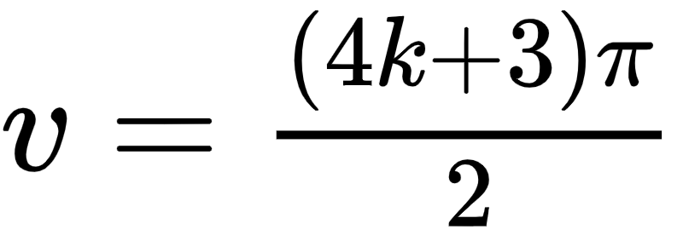
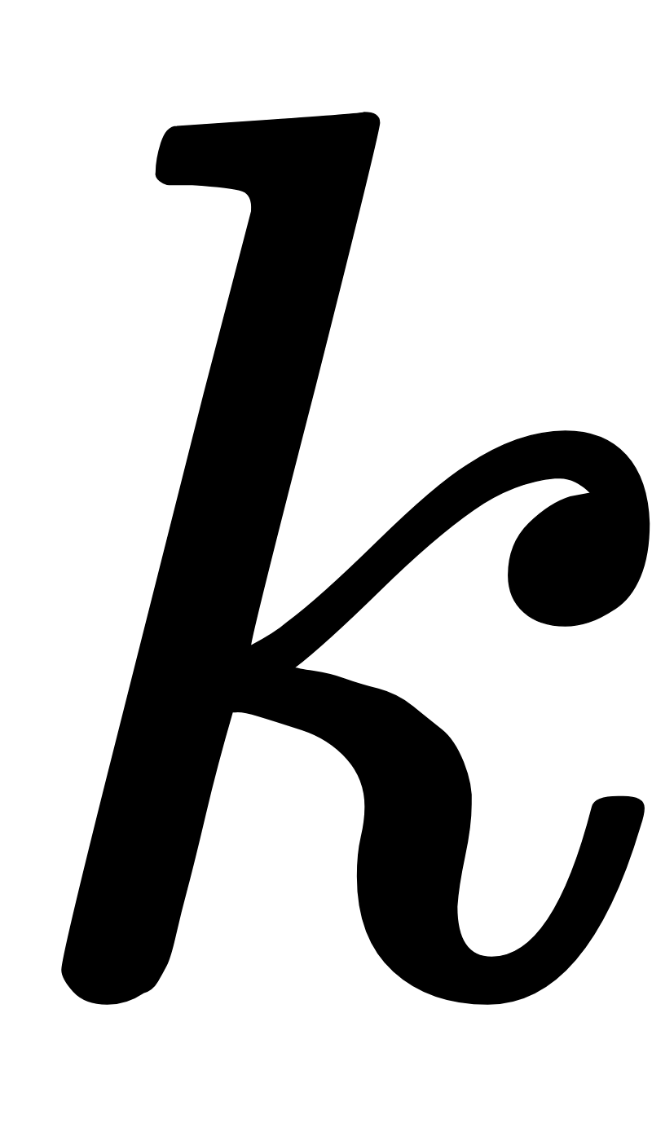
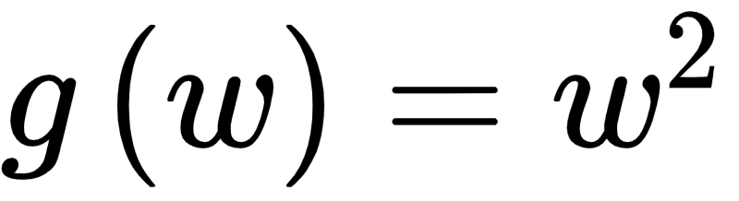
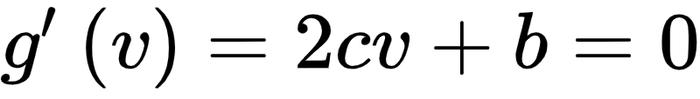
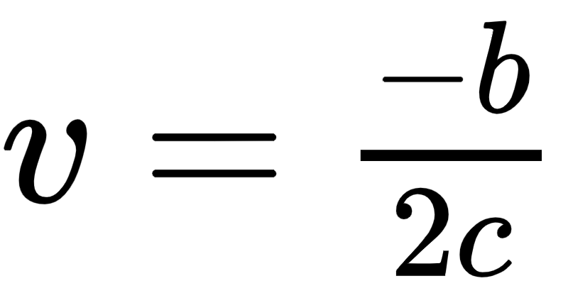
the first order condition gives stationary points wherever which occurs at odd integer multiples of , i.e., maxima at
and minima at
where is anyinteger.
for which the first order condition gives with a minimum at

Slide 25
Example: A simple looking function with difficult to compute (algebraically) global minimum

Slide 26

Solving the first order equation for even a simple looking function can be quite challenging.
Take, for example, the simple degree four polynomial
This is plotted over a short range of inputs containing its global minimum below.

Slide 27
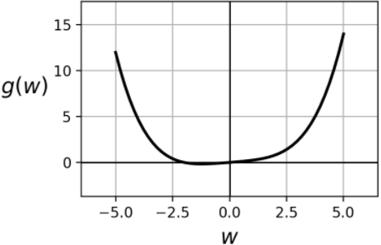

Slide 28

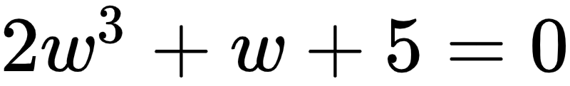
The first order system here can be easily computed as
This simplifies to

Slide 29
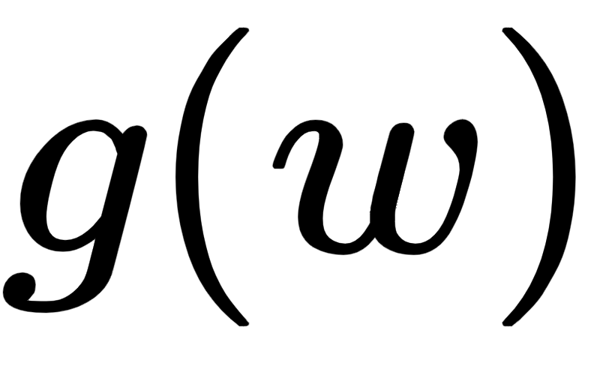
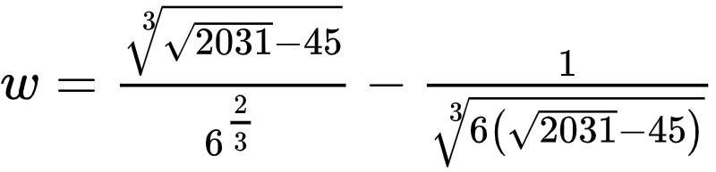
This has three possible solutions, but the one providing the minimum of the function is
which can be computed - after much toil - using centuries old tricks developed for just such problems.

Slide 30
Example: Stationary points of a general multi-input quadratic function

Slide 31


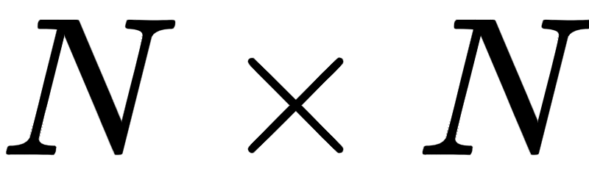

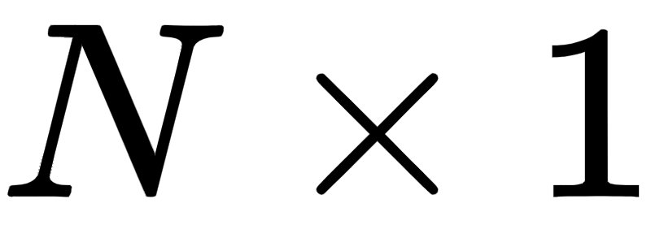

Take the general multi-input quadratic function
where is an symmetric matrix, is an vector, and is a scalar.

Slide 32
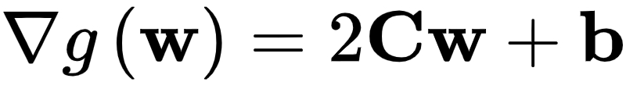
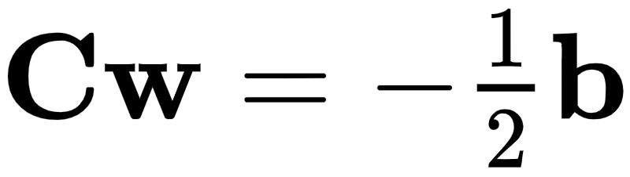
Computing the first derivative (gradient) we have
Setting this equal to zero gives a symmetric and linear system of equations of the following form whose solutions are stationary points of the original function

Slide 33
Coordinate descent and the first order optimality condition

Slide 34
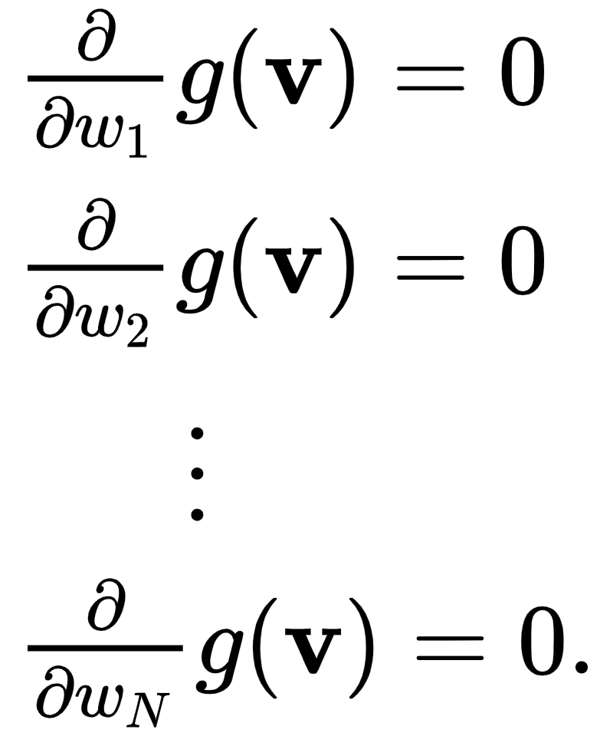
If we write out the first order system one equation at-a-time we have
While this system cannot often be solved in closed form, a simple idea does lead to numerical approach to approximating it instances where each individual equation can be easily solved.

Slide 35
The idea is this: instead of trying to solve the system of equations at once we solve each partial derivative equation one at-a-time.
This is often called coordinate descent, since in solving each we move along the coordinate axes coordinate-wise (one at-a-time).

Slide 36
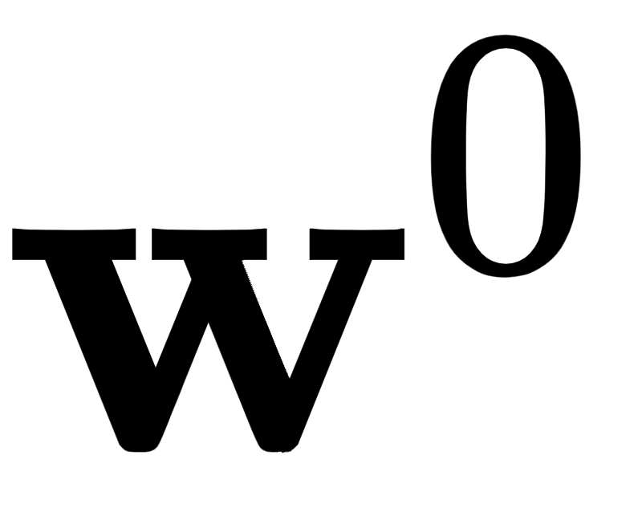
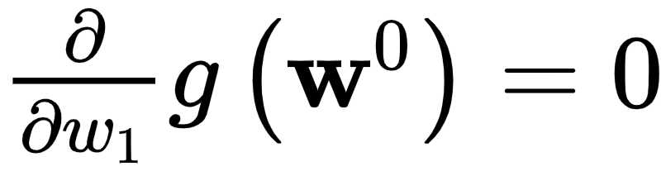

To perform this coordinate descent we initialize at a point , updating its first coordinate by solving
for the optimal first weight .
We do this again, and again, for each coordinate.

Slide 37
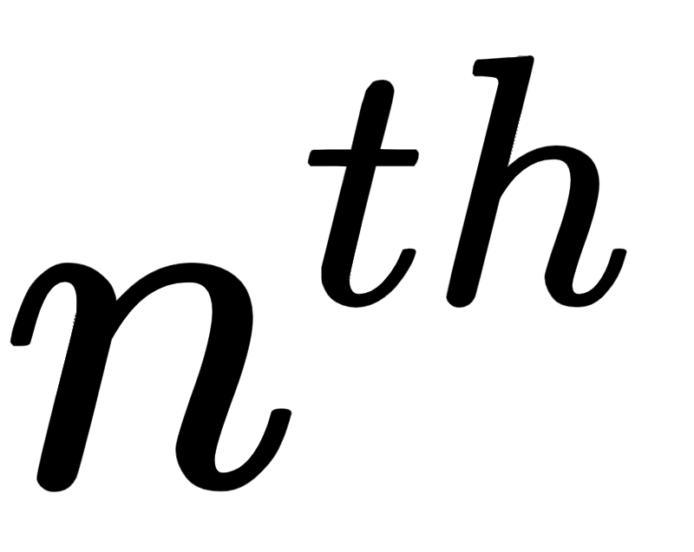
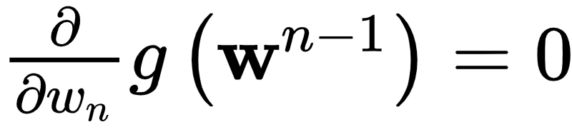

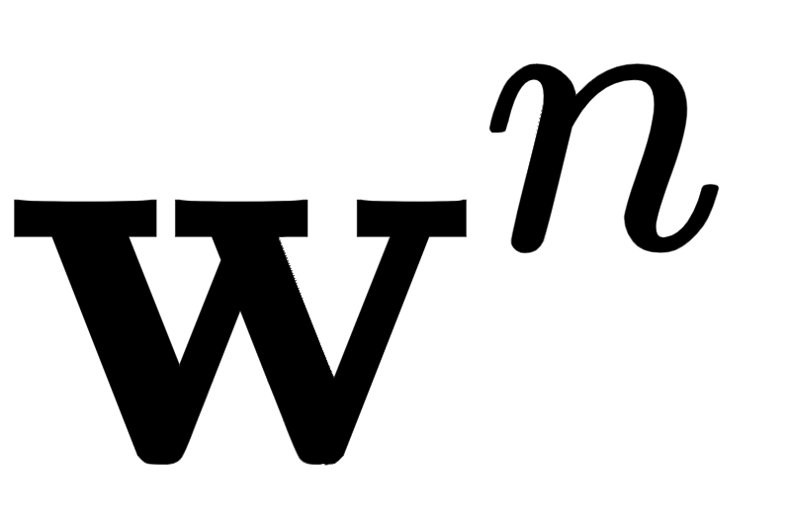
Continuing this pattern to update the weight we solve
for , and update the weight using this value forming the updated set of weights .

Slide 38
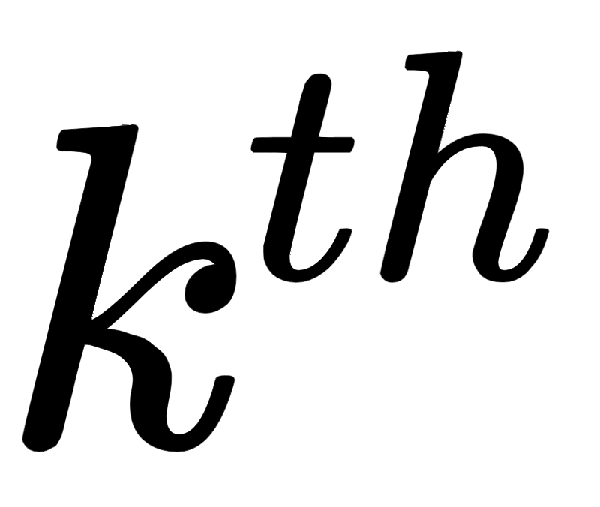
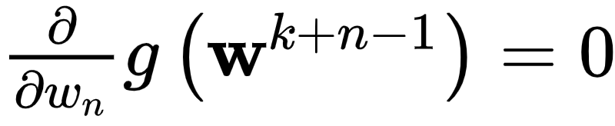
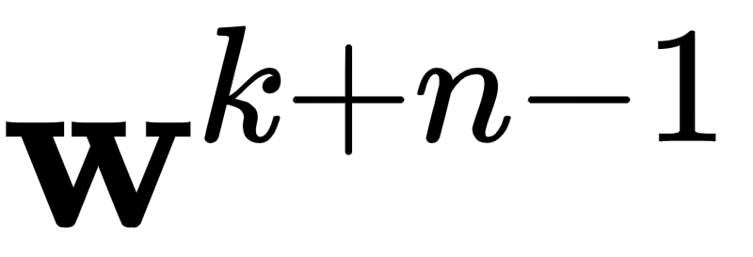
After we sweep through all N weights a single time we can refine our solution by sweeping through the weights again.
At the such sweep we update the weight by solving the single equation
and update the weight of , and so on.

Slide 39
Example: Minimizing convex quadratic functions via first order coordinate descent

Slide 40

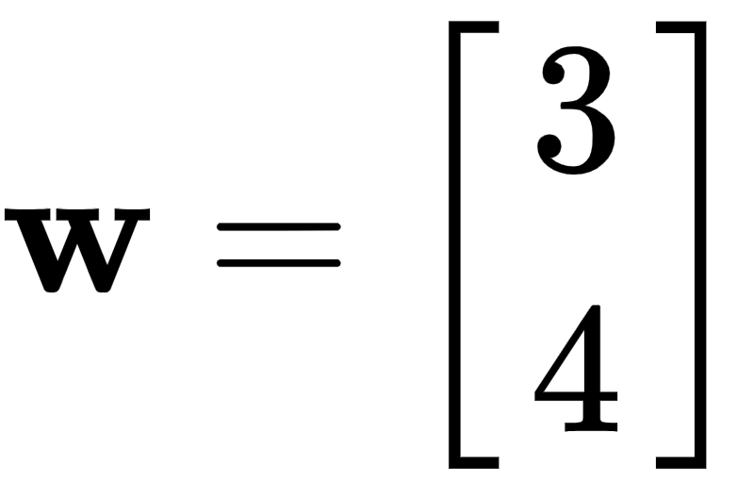
First we use this algorithm to minimize the simple quadratic
We initialize at and run 1 iteration of the algorithm - that is all it takes to perfectly minimize the function, as shown below.

Slide 41
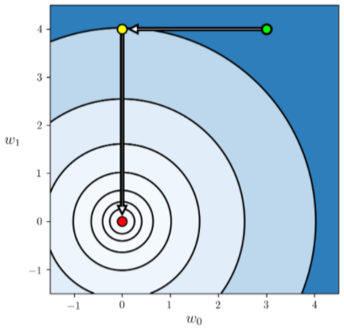

Slide 42
Below we show a run of 2 iterations of the method at the same initial point for the quadratic

Slide 43
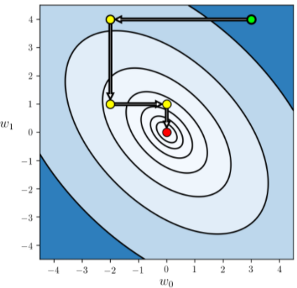

Slide 44
Example: Solving systems symmetric equations

Slide 45
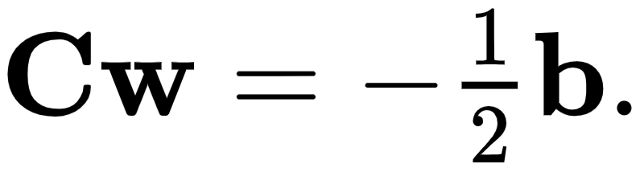
Note how in the previous example the first order system turned out to be linear.
More specifically, we ended up using coordinate descent to solve simple instances of the symmetric linear system
which generates a convex quadratic (i.e., when is positive semi-defininte).
Indeed more generally, this coordinate descent method is one very popular way of solving such systems in general.

